Slide 1



UNIT 3: School
What’s the time?

Slide 2
When does school start?
When do you usually go home?
Is that too long or too short?
Do you like being at school? Why?

Slide 3
What time is it?
10.00
It’s ten o’clock.
10.00
10.30
It’s half past ten.
o’clock = puni sat
half past = 30 minuta (10.30, 2.30…)
10.30
Let’s practise! ☺
4.00
It’s four o’clock.
4.00
7.00
7.00
It’s seven o’clock.
8.30
It’s half past eight.
8.30
3.30
3.30
It’s half past three.

Slide 4
What’s the time?
a quarter = 15 minuta
a quarter past = 15 minuta nakon
10.15
It’s a quarter past ten.
10.15
2.15
It’s a quarter past two.
2.15
Let’s practise! ☺
6.30
6.30
It’s half past six.
1.00
It’s one o’clock.
1.00
5.15
It’s a quarter past five.
5.15
9.30
It’s half past nine.
9.30
11.15
11.15
It’s a quarter past eleven.

Slide 5
a quarter = 15 minuta
a quarter to = 15 minuta do
What’s the time?
10.45
10.45
It’s a quarter to eleven. (Petnaest minuta je do 11 sati.)
6.45
6.45
It’s a quarter to seven. (Petnaest minuta je do 7 sati.)
a quarter = 15 minuta
a quarter to = 15 minuta do
6.15
6.15
It’s a quarter past six.
Let’s practise! ☺
1.45
1.45
It’s a quarter to two.
5.30
It’s half past five.
5.30
2.00
It’s two o’clock.
2.00
12.45
It’s a quarter to one.
12.45

Slide 6
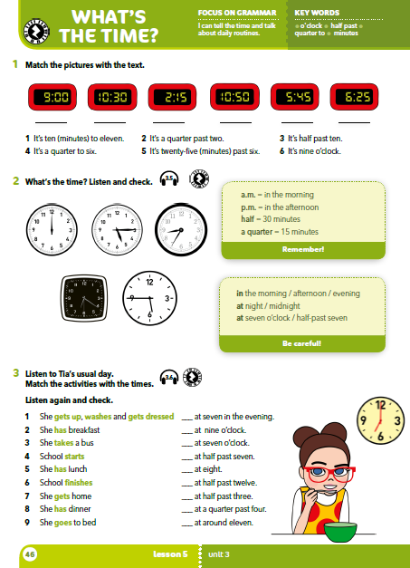
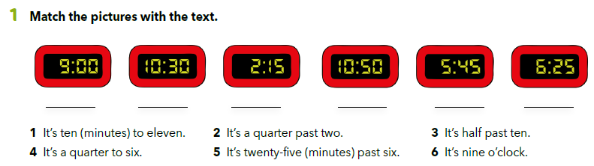
Match the sentences and the pictures. Write the correct number on the line.
6
3
2
1
4
5

Slide 7
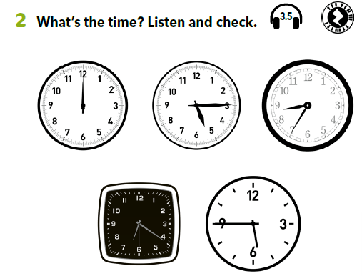

Look at the pictures and write what’s the time in full sentences in your notebook.
Listen and check your answers.
It’s twelve o’clock.
It’s a quarter past five.
It’s eight thirty-five (or It’s twenty-five to nine).
It’s twenty past six.
It’s a quarter to six.
https://www.e-sfera.hr/dodatni-digitalni-sadrzaji/69bcdfc9-0405-48c9-b5e4-5cb8704f014c/assets/audio/23_time.mp3

Slide 8
School starts at 8 a.m.
I have lunch at 3 p.m.
Škola počinje u 8 ujutro.
Ručam u 3 popodne.
Izrazom a.m. označavamo jutarnje sate (od ponoći do podneva),
a izrazom p.m. popodnevne/večernje sate (od podneva do ponoći)

Slide 9
in the morning =
in the afternoon =
in the evening =
at night =
at midnight =
at seven o’clock. =
at half past nine. =
half =
12.30 → It’s half past twelve.
a quarter =
It’s a quarter past eleven.→ 11.15
It’s a quarter to five. → 4.45
ujutro
30 minutes
popodne
navečer
noću
u ponoć
15 minutes
u 7 sati
u 9.30

Slide 10
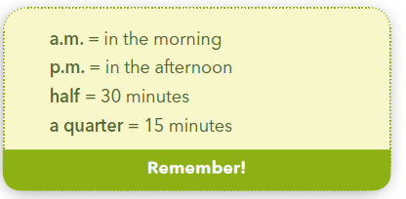
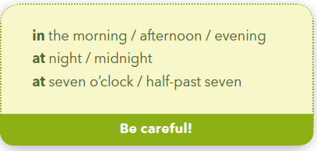
Write your own sentences using these expressions.

Slide 11
Let’s practise!
What’s the time? Click on the link and complete the task.
https://learningapps.org/view4791042

Slide 12
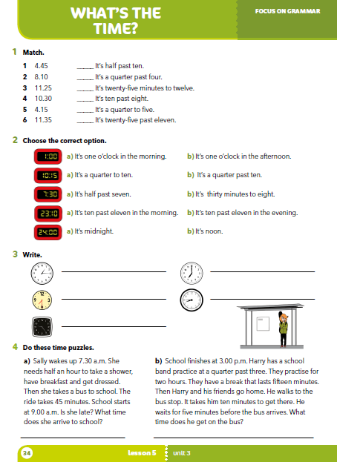
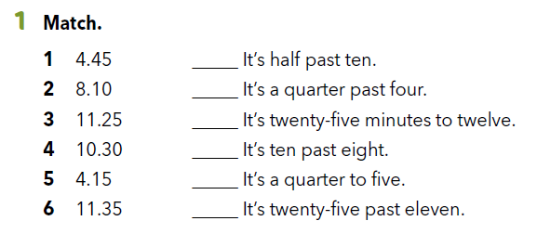
Workbook p 34.
4
5
6
2
1
3

Slide 13
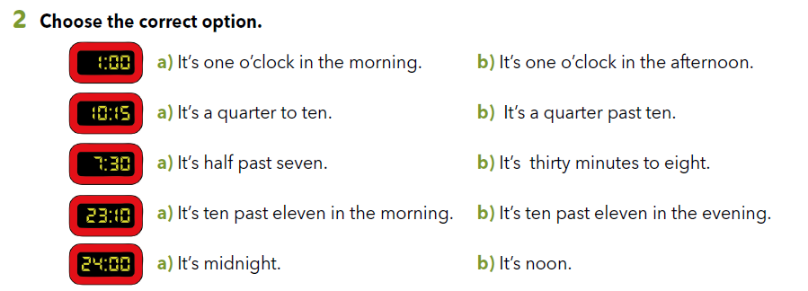

Slide 14
Let’s practise!
Click on the following link and play the game.
http://learnenglishkids.britishcouncil.org/word-games/time

Slide 15
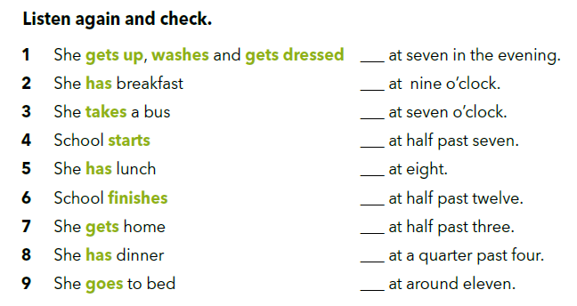
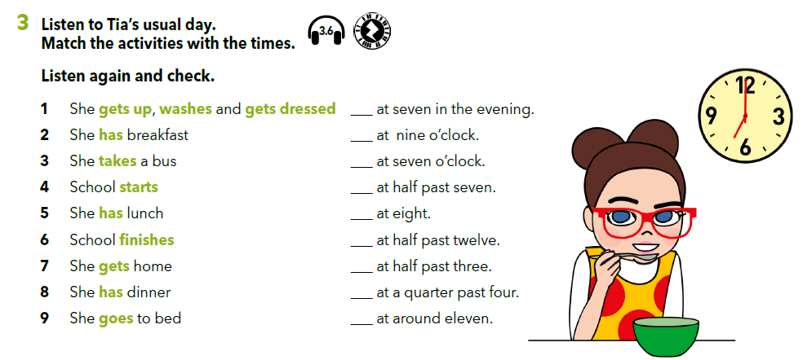
Try and match the activities with the times.
8
4
1
https://www.e-sfera.hr/dodatni-digitalni-sadrzaji/69bcdfc9-0405-48c9-b5e4-5cb8704f014c/assets/audio/24_tia_day.mp3
2
3
5
6
7
9

Slide 16
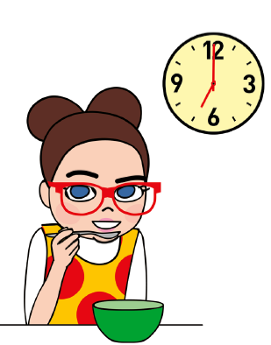
Is your day similar to Tia’s?
What’s different?
What’s the same?
Do you have difficult subject before the break?
Do you think that’s a good idea?

Slide 17
Describe your typical day to your friend.
He/She listens to you and writes down notes.
After that, he/she uses the notes and describes your day.
VAŽNO: Kad opisujemo dan druge osobe u glagolskom vremenu Present Simple u 3. l.jd ( kad koristimo izraze He, She ili It) moramo na glagol dodati nastavak –s ili –es.

Slide 18
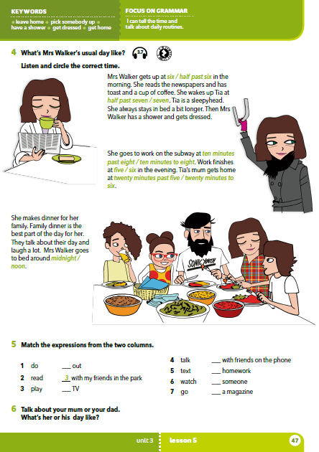
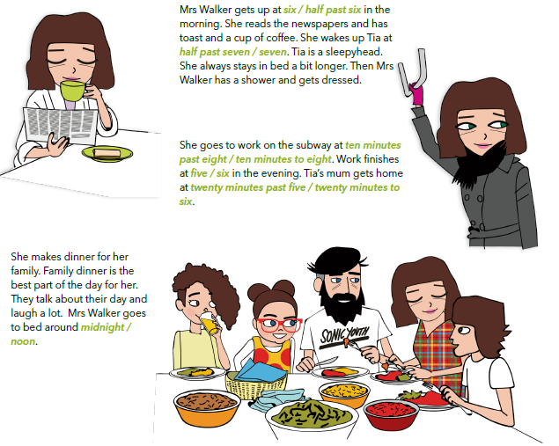
Who is this?
What do you think her day is like?
What does she do in the morning / afternoon / evening?

Slide 19
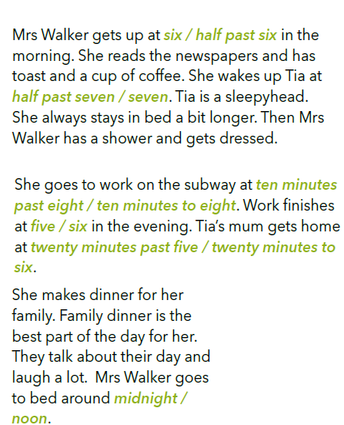
Listen and circle the correct time.
https://www.e-sfera.hr/dodatni-digitalni-sadrzaji/69bcdfc9-0405-48c9-b5e4-5cb8704f014c/assets/audio/25_ms_walker.mp3

Slide 20
What do these words mean?
a sleepyhead =
have a shower =
get dressed =
subway =
get home =
spavalica
tuširati se
odjenuti se
podzemna željeznica
doći doma, kući

Slide 21
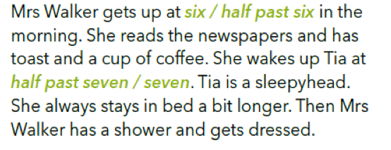
Read the text again and answer the questions.
What is the first thing she does in the morning?
What does she have for breakfast?
What does she do after she wakes Tia up?

Slide 22
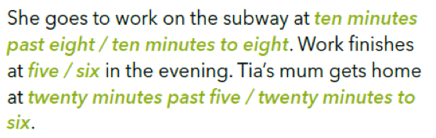
Read the text again and answer the questions.
How does she get to work?
What is subway?
How long does it take for her to get from work to home?

Slide 23
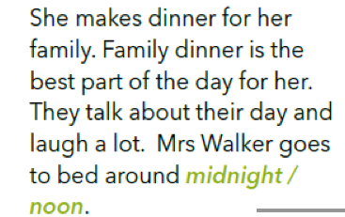
Read the text again and answer the questions.
How does she feel about having dinner with her family?
What do they do during dinner?

Slide 24
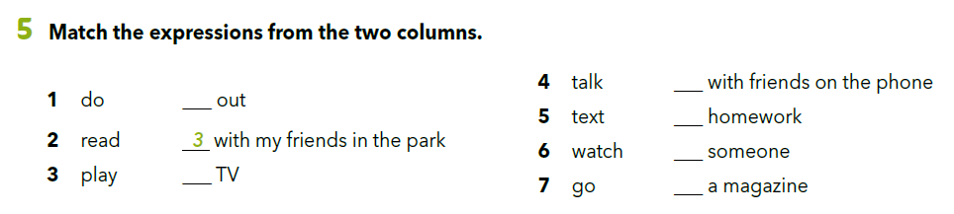
4
7
1
5
6
2

Slide 25
Translate
do homework =
read a magazine =
talk with friends on the phone =
text someone =
go out =
pisati zadaću
čitati časopis
pričati s prijateljima na telefon
dopisivati se s nekim (putem sms poruke)
ići vani

Slide 26

Opiši jedan tipičan dan svojih roditelja (mame ili tate) ili nekog drugog starijeg člana obitelji.
Opiši dan u šest rečenica: dvije rečenice neka se odnose na jutro, dvije rečenice na popodne i dvije rečenice o večeri.
Opis napiši u svoju bilježnicu.

Slide 27
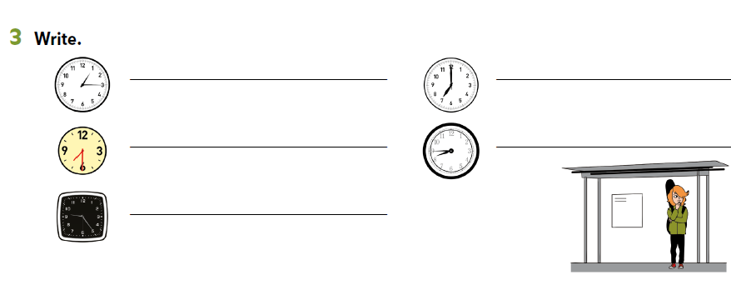
Workbook p 34.
It’s a quarter past one.
It’s a seven o’clock.
It’s half past seven.
It’s a quarter to nine.
It’s twenty-five (minutes) past nine.

Slide 28
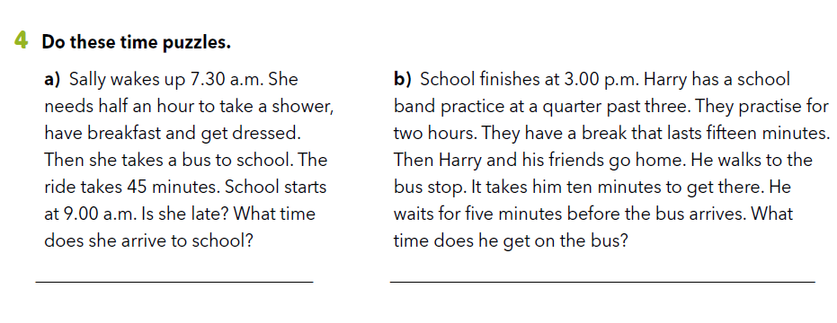
No, she isn’t. She arrives to school at 8.45 a.m.
He gets on the bus at 5.45 p.m.

Slide 29
Let’s revise!
Revise the new words about daily routine.
https://quizlet.com/298537617/daily-routine-flash-cards/

Slide 30

SELF CHECK
https://www.e-sfera.hr/dodatni-digitalni-sadrzaji/69bcdfc9-0405-48c9-b5e4-5cb8704f014c/

Slide 31
LEARN MORE
https://www.e-sfera.hr/dodatni-digitalni-sadrzaji/69bcdfc9-0405-48c9-b5e4-5cb8704f014c/
A security guard’s day

